Slide 1

BenchQ
A Powerful Open Source
Fault Tolerance Resource Estimation Tool
Athena Caesura
Quantum Software Engineer

Slide 2



























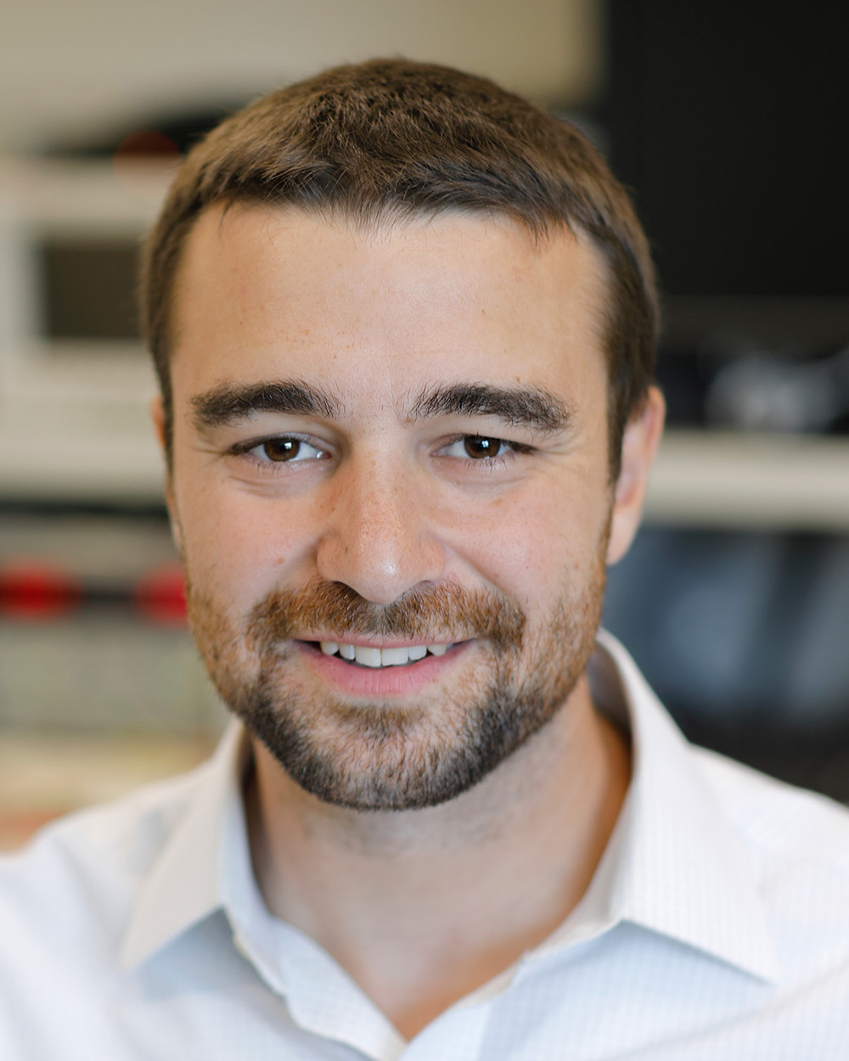



The BenchQ Ecosystem

Slide 3
BenchQ Motivation: Automatic Detailed Estimates
BenchQ
Compilation
Footprint Analysis
Footprint Analysis
Count T gates
Individual Studies
Estimated Compilation
Slow
Automatic Estimates

Slide 4
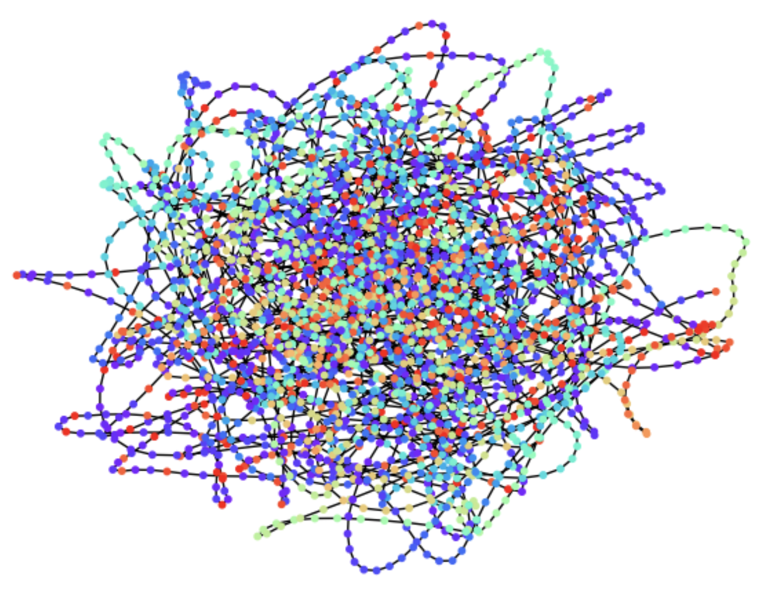
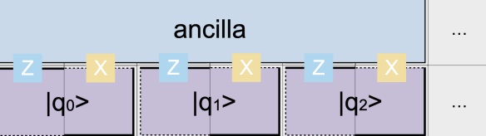
Graph State Compilation: BenchQ’s Secret Sauce
QSP Circuit for
Simulation of H-chain
ALGORITHMS:
QSP
Trotterization
QAOA
Linear Differential Equations

Slide 5
BenchQ Recipe
Algorithm Implementation
Architecture Model
Resource Estimation Pipeline
Resource Info

Slide 6
Algorithm Implementation
QSP
Trotter
LDE Solver (WIP)
Resource Estimator
Graph State Compilation
Instance
Resource Info
Footprint Analysis
Extrapolated GSC
MAGLAB Instances
Catalysis Instances
Hamiltonian Simulation
Triangular
Cubic
Kitaev
QAOA
BenchQ Recipe

Slide 7
BenchQ Recipe – Advanced
Algorithm Implementation
Resource Estimator
Transformers
Resource Info

Slide 8
Hardware Models
Basic
Super-Conducting
Trapped Ion
Detailed
IonQ
Decoder
Architecture
Time
Space^{3,4}
Resource Estimator
Magic State Distillation Factory
Litinski¹
AutoCCZ²
Extrapolation Parameters
Extrapolation Steps
Fast Compilation
Optimal Compilation
Some BenchQ Parameters

Slide 9
How to Contribute
Hardware Specialist
New Hardware Models
New Qubit Layouts
Compiler Specialist
Compiler Improvement
Circuit Optimization
Algorithm
Specialist
New Algorithms
Improvements
Neutral Atoms
Superconducting
DE solver
Compare your algo to SOTA!
Better simulation techniques
More Block Encodings!
Minimize gates
Reduce communication qubits
Minimize connectivity
Active Volume
Improve qubit layouts
New to FT Quantum
Control Flow
Automatic compilers
Integrate new hardware models
Tidying Up
Consistent terminology
Performance Engineering
Photonics

Slide 10
In Summary
BenchQ is an AMAZING tool.
Simple and Advanced modes. Advanced mode crazy number of features
Circuit compilation in resource estimation
Contribute to BenchQ
Curious? Just pip install benchq.

Slide 11
Thank you – come see me after!
Athena Caesura
athena.caesura@zapata.ai

Slide 12
Citations
D. Litinski, “Magic state distillation: Not as costly as you think,” Quantum 3, 205 (2019).
C. Gidney and A. G. Fowler, “Efficient magic state factories with a catalyzed |CCZ> to 2|T> transformation,” Quantum, vol. 3, p. 135, 2018.
M. Vijayan et al., “Compilation of algorithm-specific graph states for quantum circuits,” arXiv:2209.07345v.
S. Liu et al., “A Substrate Scheduler for Compiling Arbitrary Fault-tolerant Graph States,” arXiv: 2306.03758v2.

